Slide 1
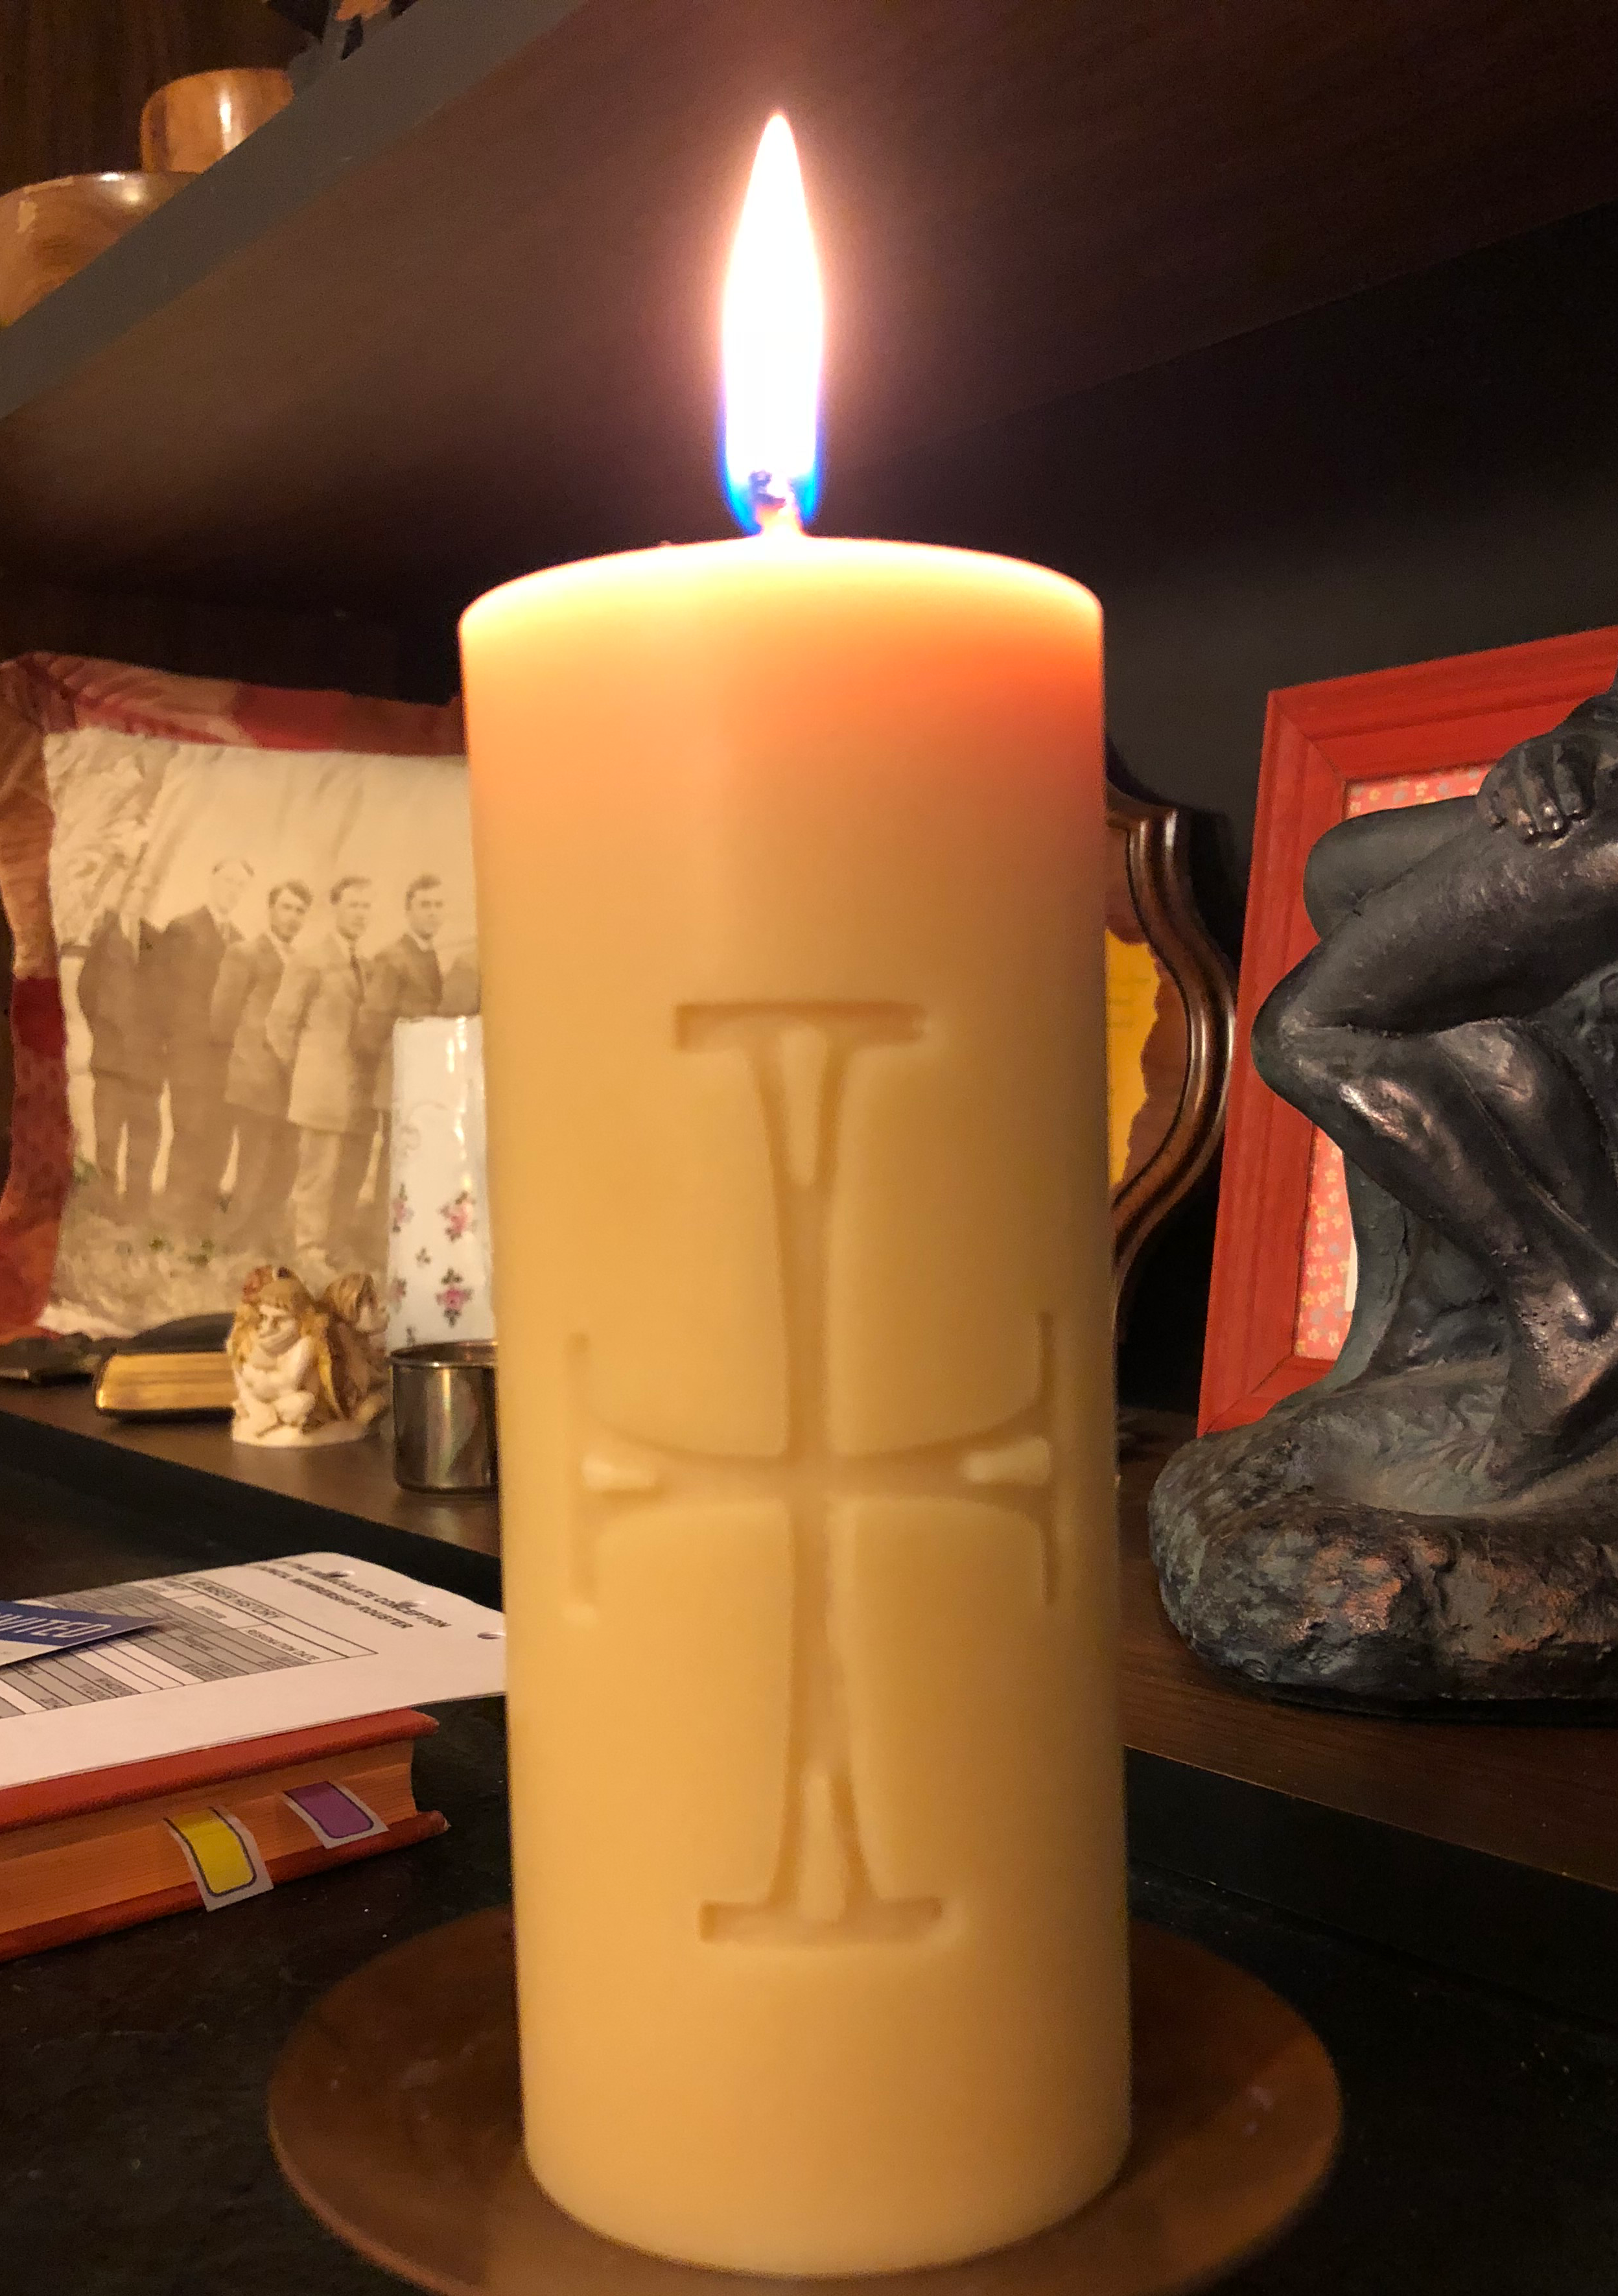
EXTRAORDINARY MINISTERS OF HOLY COMMUNION TO THE SICK AND HOMEBOUND
Diocese of Kansas City-St. Joseph
www.paulturner.org/workshops

Slide 2
Outline for the Day
1. Welcome
2. Importance of this ministry
3. Communion of the Sick
4. Case Studies
5. Questions
6. Prayer

Slide 3
Liturgical books

Slide 4
A Ritual for Laypersons (Liturgical Press)
Resources

Slide 5
Pastoral Care of the Sick 43
The concern that Christ showed for the bodily and spiritual welfare of those who are ill is continued by the Church in its ministry to the sick. This ministry is the common responsibility of all Christians, who should visit the sick, remember them in prayer, and celebrate the sacraments with them. The family and friends of the sick, doctors and others who care for them, and priests with pastoral responsibilities have a particular share in this ministry of comfort. Through words of encouragement and faith they can help the sick to unite themselves with the sufferings of Christ for the good of God’s people.

Slide 6
Holy Communion and Eucharistic Worship Outside Mass
II. Purpose of Eucharistic Reservation

Slide 7
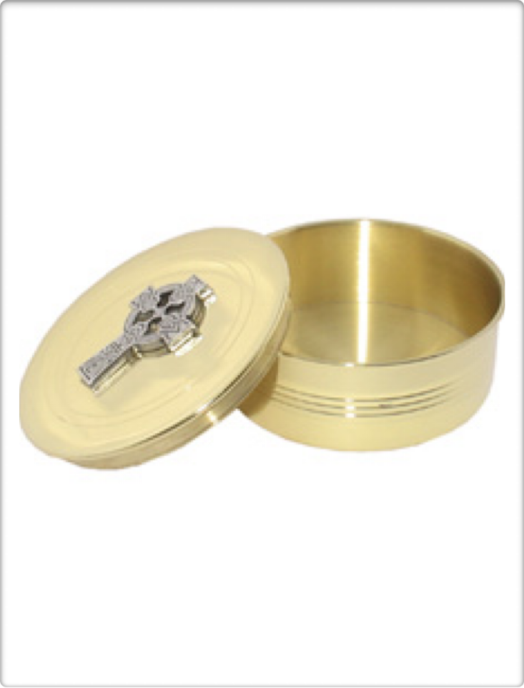
5. Reasons
“The primary and original reason for reservation of the eucharist outside Mass is the administration of viaticum. The secondary ends are the giving of communion and the adoration of our Lord Jesus Christ present in the sacrament.”

Slide 8
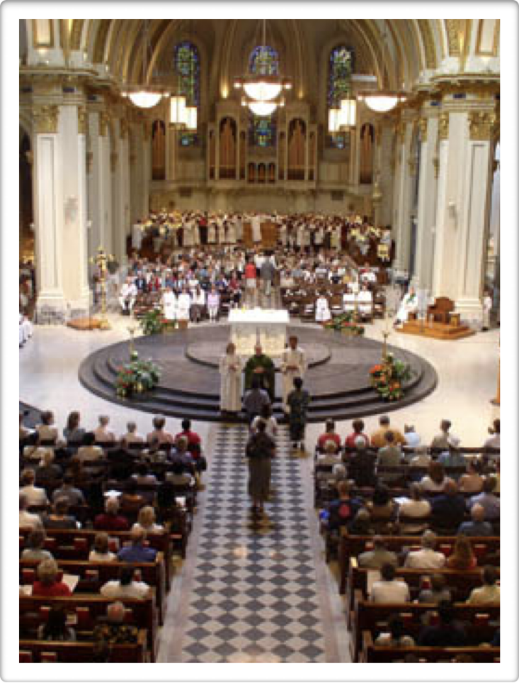
6. The Presence of Christ at Mass
“in the very assembly of the faithful, gathered together in his name”
“in his word, with the reading and explanation of Scripture in the church”
“in the person of the minister”
“above all, in the eucharistic elements”

Slide 9
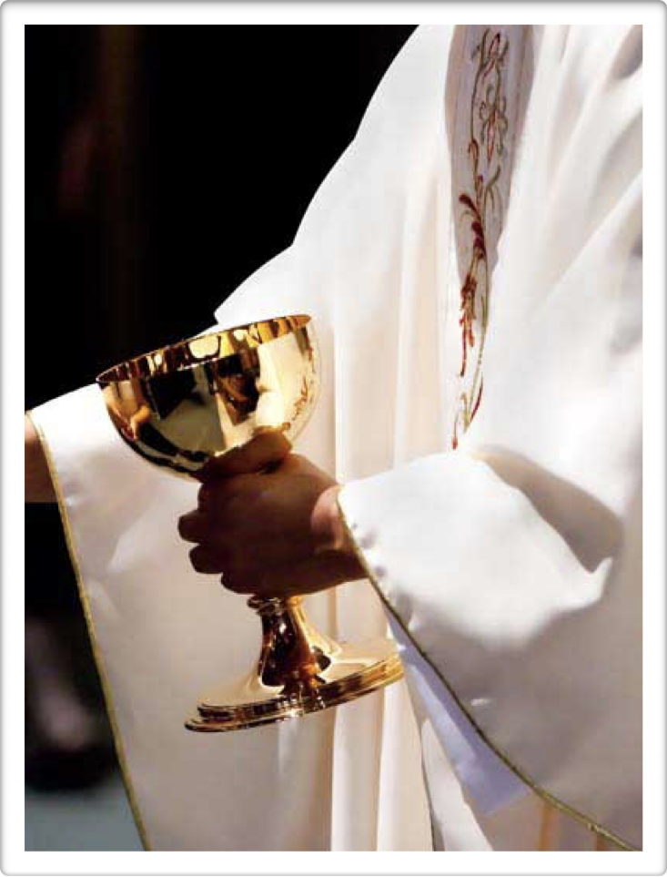
6. The Presence of Christ at Mass
“In a way that is completely unique, the whole and entire Christ, God and man, is substantially and permanently present in the sacrament. This presence of Christ under the appearance of bread and wine ‘is called real, not to exclude the other kinds of presence as though they were not real, but because it is real par excellence.’”

Slide 10
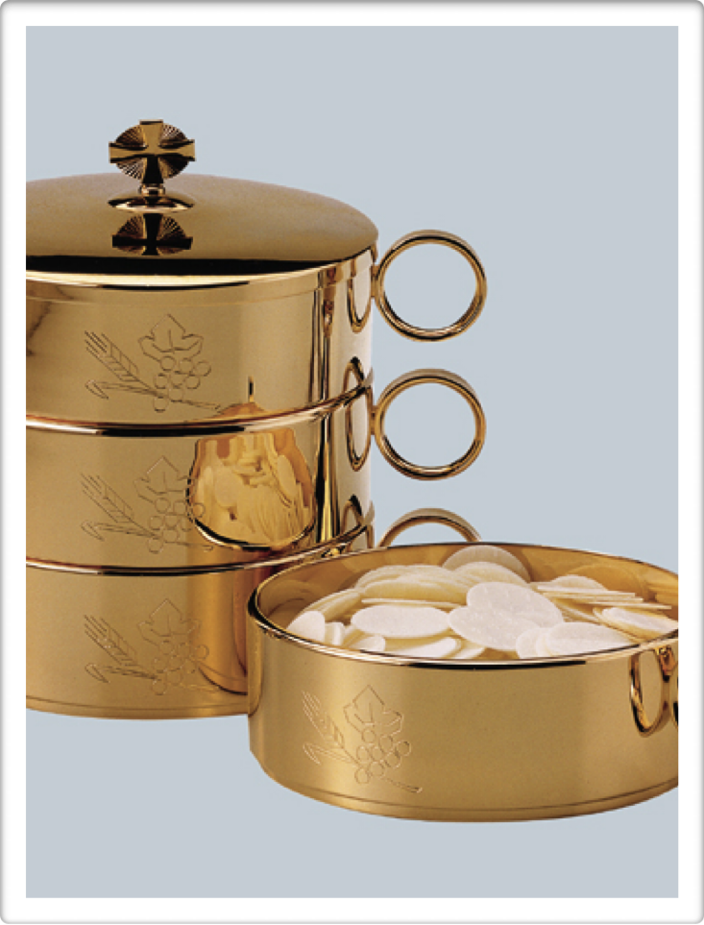
7. Hosts
“The consecrated hosts are to be frequently renewed and reserved in a ciborium or other vessel in a number sufficient for the communion of the sick and of others outside Mass.”

Slide 11
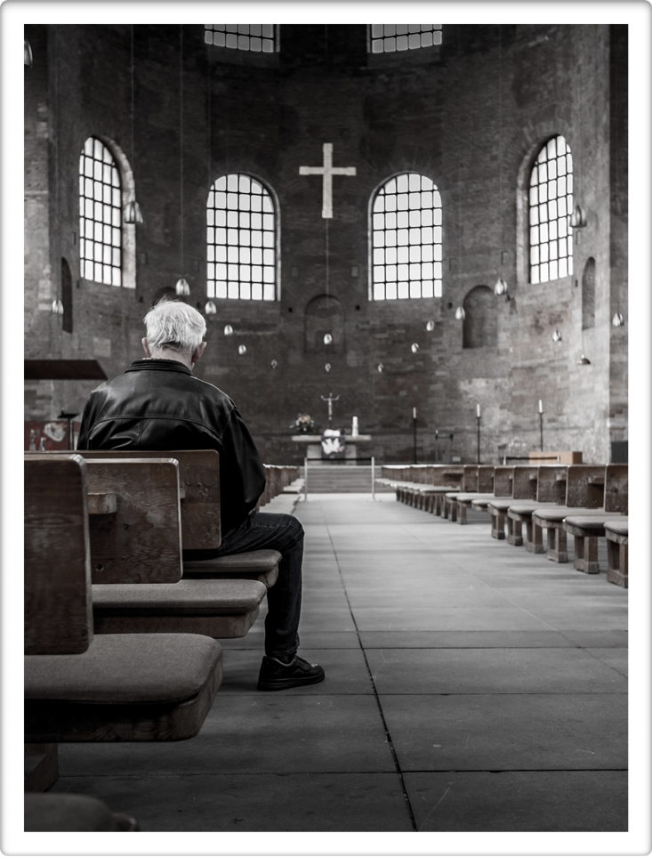
8. Praying
Pastors should see that churches “are open every day for at least several hours at a convenient time, so that the faithful may easily pray in the presence of the blessed sacrament.”

Slide 12
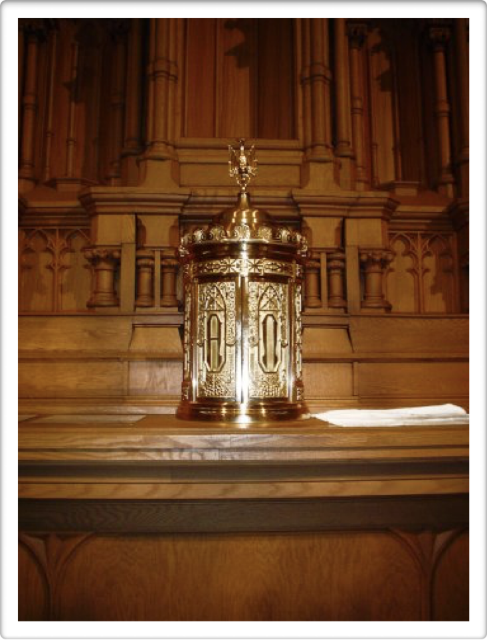
10. Tabernacle
“The holy eucharist is to be reserved in an immovable and solid tabernacle. It must be opaque and locked in such a way as to provide every possible security against the danger of desecration. Ordinarily there should be only one tabernacle in a church.”

Slide 13
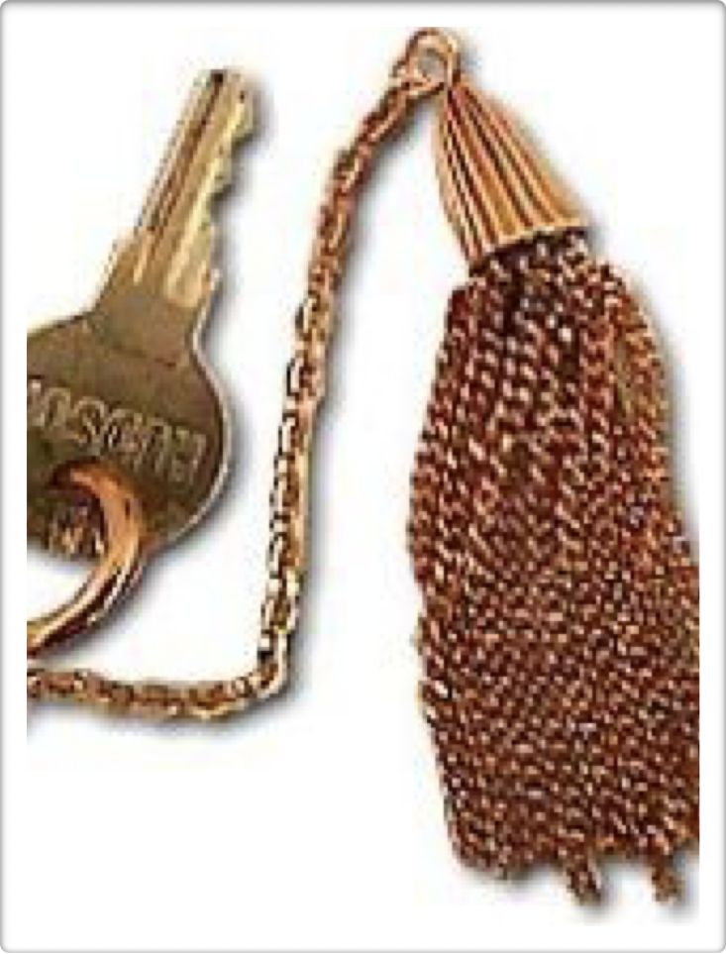
10. Tabernacle
“The one in charge of the church or oratory is to see to it that the key to the tabernacle where the eucharist is reserved is safeguarded most carefully.”

Slide 14
Holy Communion and Worship of the Eucharist Outside Mass: 15. Still Sharing the Banquet
When the faithful “receive communion outside Mass, they are closely united with the sacrifice that perpetuates the sacrifice of the cross. They are sharers in the sacred banquet.”

Slide 15
Communion to the sick or homebound
Minister Training: Diocese of Kansas City - St. Joseph

Slide 16
HOW DO WE USE THE BOOKLET FOR COMMUNION TO THE SICK?

Slide 17
Service | Recipient | Minister
Visiting the Sick | Any sick person | Anyone
Communion | Any sick person eligible and capable | Communion minister
Anointing | Reality or possibility of serious illness | Priest
Reconciliation | Any eligible sick person | Priest
Viaticum | One who is dying | Communion minister
Apostolic Pardon | One who is dying | Priest
Prayers for the dying | One who is dying | Anyone
Prayers for the dead | One who has died | Anyone

Slide 18
Preparations
Bring appropriate materials: ritual book, parish bulletin
“Those who are with the sick should be asked to prepare a table covered with a linen cloth upon which the Blessed Sacrament will be placed. Lighted candles are prepared and, where it is customary, a vessel of holy water” PCS 74
Traveling with the Blessed Sacrament in your car

Slide 19
Occasion
Ideally, from Sunday mass to the home, bringing communion consecrated at that mass
Ministering on Holy Thursday after the Mass of the Lord’s Supper

Slide 20
USCCB: Introduction to the Order of Mass
21: When Holy Communion is being taken from Mass to the sick or those unable to leave their homes, the priest gives the pyx containing the Holy Eucharist to the deacons, acolytes, or extraordinary ministers of Holy Communion immediately after Communion has been distributed. Alternatively, they may depart immediately after receiving Communion themselves, or even as part of the concluding procession of ministers.

Slide 21
Holy Communion and Worship of the Eucharist Outside Mass: 14. The Sick and Elderly
The sick and the elderly should “be given the opportunity even if they are not gravely ill or in imminent danger of death, to receive the eucharist often, even daily, especially during the Easter season. It is lawful to minister communion under the form of wine to those who cannot receive the consecrated bread.”

Slide 22
Redemptionis Sacramentum 132:
No one may carry the Most Holy Eucharist to his or her home, or to any other place contrary to the norm of law.

Slide 23
Holy Communion and Worship of the Eucharist Outside Mass 20. The Pyx
Outside a church, carry communion “in a pyx or other covered vessel”
Vesture and manner of carrying the eucharist should be “appropriate and in accord with local circumstances”

Slide 24
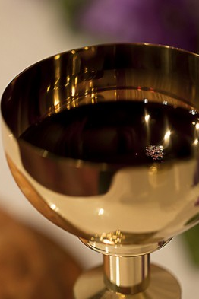
PCS 74
Sick people who are unable to receive Communion under the form of bread may receive it under the form of wine alone.

Slide 25
PCS 74
If the wine is consecrated at a Mass not celebrated in the presence of the sick person, the Blood of the Lord is kept in a properly covered vessel and is placed in the tabernacle after Communion. The Precious Blood should be carried to the sick in a vessel which is closed in such a way as to eliminate all danger of spilling.

Slide 26
Holy Communion and Worship of the Eucharist Outside Mass 19. Preparations
In a church or oratory, “a corporal is to be placed on the altar, which is already covered with a cloth, and there are to be two lighted candles…. A communion plate is to be used.”
In other places, a suitable table with a cloth, candles

Slide 27
Canon 919
The elderly, the infirm, and those who care for them can receive the Most Holy Eucharist even if they have eaten something within the preceding hour.

Slide 28
Practical questions
What if the sick person declines communion?
What if the sick person is gluten intolerant?
What if the sick person is alcohol intolerant?
What if the sick person spits out the host?
May a non-Catholic receive communion?

Slide 29
After the visit
Leftover hosts
  May be returned to church immediately
  May be consumed by those present, including the minister
Maintain confidentiality, but communicate essentials with your pastor

Slide 30
Holy Communion and Worship of the Eucharist Outside Mass 22. Cleansing
“Fragments remaining after communion are to be gathered and placed in a ciborium or in a vessel with water.”
“[a] chalice or other vessel is to be washed with water.”
“The water… may be drunk or poured out in a suitable place.”

Slide 31
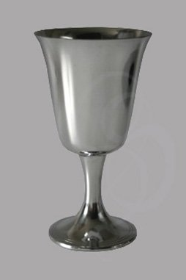
PCS 74
If some of the Precious Blood remains, it should be consumed by the minister, who should also see to it that the vessel is properly purified afterward.

Slide 32
Viaticum
Minister Training: Diocese of Kansas City - St. Joseph

Slide 33
Code of Canon Law
921 §1. The Christian faithful who are in danger of death from any cause are to be nourished by holy communion in the form of Viaticum.
§2. Even if they have been nourished by holy communion on the same day, however, those in danger of death are strongly urged to receive communion again.

Slide 34
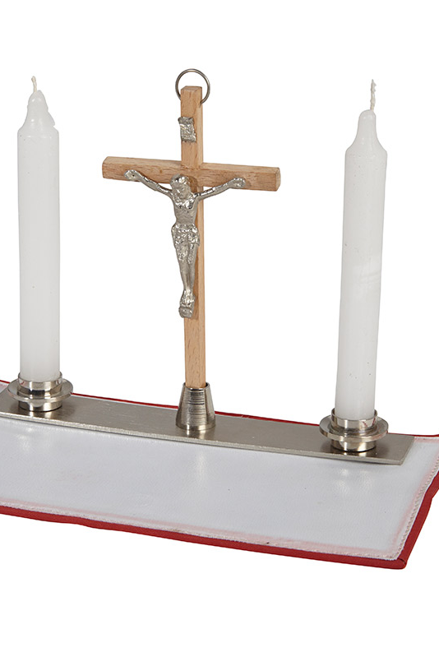
Code of Canon Law
§3. While the danger of death lasts, it is recommended that holy communion be administered often, but on separate days.
922 Holy Viaticum for the sick is not to be delayed too long; those who have the care of souls are to be zealous and vigilant that the sick are nourished by Viaticum while fully conscious.

Slide 35
Enchiridion on Indulgences 28: The Moment of Death
To the faithful in danger of death, who cannot be assisted by a priest to bring them the sacraments and impart the Apostolic Blessing with its plenary indulgence (see can. 468, 2 of Code of Canon Law), Holy Mother Church nevertheless grants a plenary indulgence to be acquired at the point of death, provided they are properly disposed and have been in the habit of reciting some prayers during their lifetime. The use of a crucifix or a cross to gain this indulgence is praiseworthy.
The condition: provided they have been in the habit of reciting some prayers during their lifetime supplies in such cases for the three usual conditions required for the gaining of a plenary indulgence.

Slide 36
After the reading: Minister: Do you believe in God, the Father almighty, creator of heaven and earth? Response: I do. Minister: Do you believe in Jesus Christ, his only Son, our Lord, who was born of the Virgin Mary, was crucified, died, and was buried, rose from the dead, and is now seated at the right hand of the Father? Response: I do. Minister: Do you believe in the Holy Spirit, the holy catholic Church, the communion of saints, the forgiveness of sins, the resurrection of the body, and life everlasting? Response: I do.

Slide 37
After the Lord’s Prayer: Minister: The body of Christ (or: The blood of Christ). Response: Amen. Minister: May the Lord Jesus Christ protect you and lead you to eternal life. Response: Amen.

Slide 38

Other Prayers
Commendation of the Dying
Prayers for the Dead

